Slide 1
Convex Optimization: , A library of solvers
Fasil Cheema

Slide 2
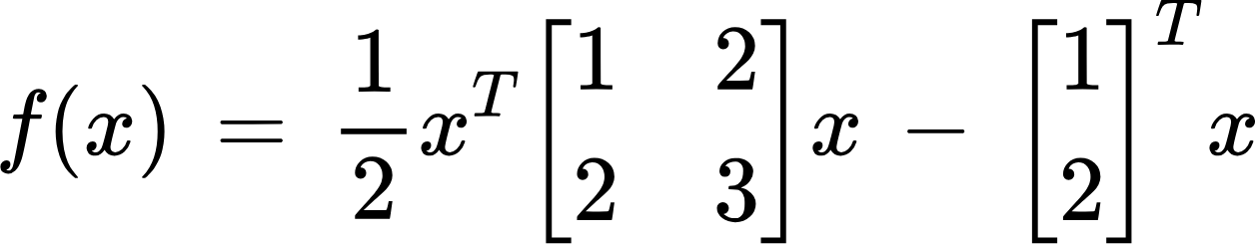
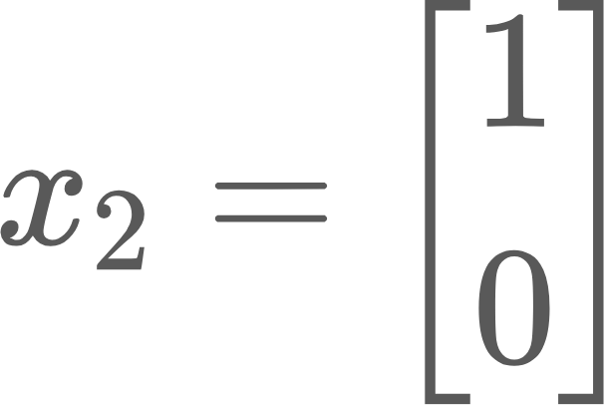
Solving a Minimization problem
An ML engineer would like to minimize the following loss function:
We should be able to take one of the functions in our library (in this case Fletcher-Reeves Conjugate gradient method), with an initial starting point.
In this case the conjugate gradient algorithm is guaranteed to solve a quadratic of n variables in n steps; so 2 iterations will return optimal solution:

Slide 3
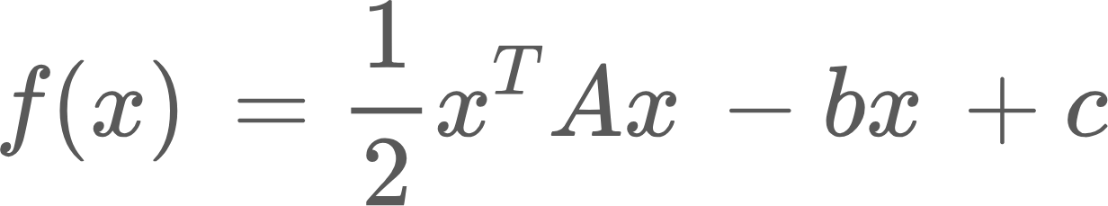
The Problem
Given a convex optimization problem that we seek to minimize of the form:
Apply one of the several algorithms in the library such as David Fletcher Powell, Fletcher Reeves, BFGS (there are other methods such as Trust Region, Newton method, steepest descent)

Slide 4
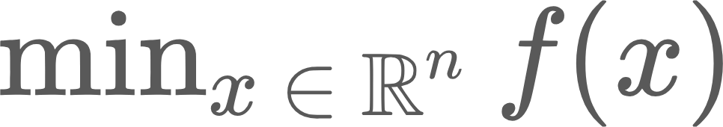
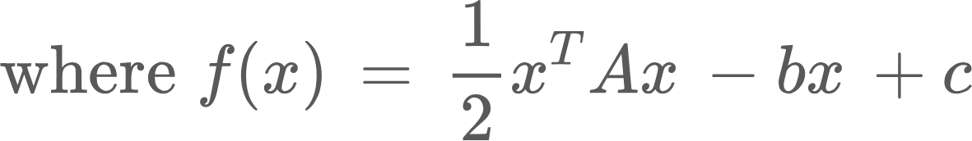
Goal Statements
GS1: Given the initial value, function, stopping conditions minimize a function given if it satisfies constraints
GS2: Verify input is valid
GS3: Return the value of the algorithm on one of the stopping conditions

Slide 5
Assumptions
The input will always be expressed in the quadratic form (can be linear or even constant)
The function is convex (?)
The dimension of the matrices can never exceed the dimension limit (3)
The users are educated in the subject matter (no GUI)

Slide 6
Data Constraints
Inputs:
Function to minimize (in appropriate form)
Stopping conditions (number of steps, accuracy, can be function specific)
Initial starting value
Depending on function; hyperparameters
Outputs:
The optimal solution; or final value when algorithm terminated
Number of steps
Can also output values used along the way such as nth steps step size, or other algorithm specific values

Slide 7
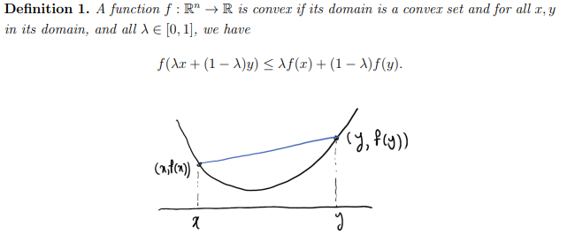
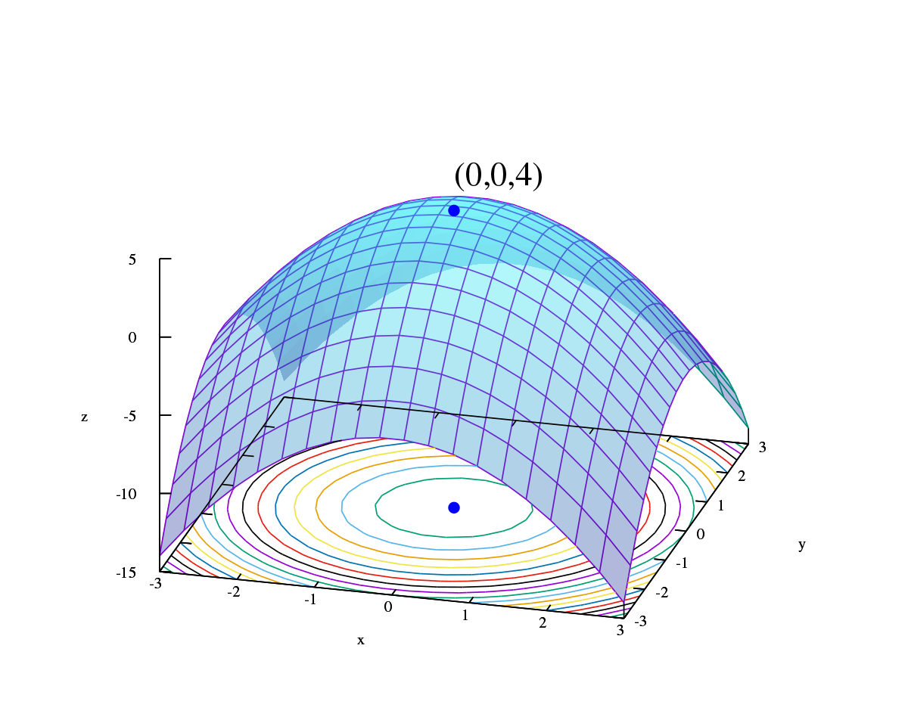
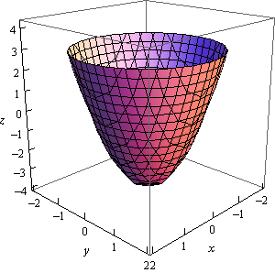
General Definitions and Theoretical Models
Convexity:
Function Minimization:

Slide 8
Instanced Models
Using Fletcher-Reeves and an initial starting point of x_0 = (0,1)^T and using exact line search minimize the above
Using DFP and using exact line search, with initial H_0 = I, and starting point x_0 = (0,1)^T minimize the above

Slide 9
Thank you for listening!
Questions or comments?

